Slide 1
Coloring User Engagement
In Stock Photography
An analysis of the effects of color measured on user engagement
Aaron Lee

Slide 2
Question
Does the color in an image affect whether a person engages with that picture or not?

Slide 3
What is Unsplash.com?
Stock photography website
Download and use without paying royalties
Advertisement
Graphics
Pictures in articles
Etc.
Specific Photo meta-data
View, downloads, user, upload date, COLOR, etc.
Notes:
Free stock photography site with photos to be used for any creative purpose:
Advertisement
Graphics
Pictures in Articles
Etc.
You name it!

Slide 4
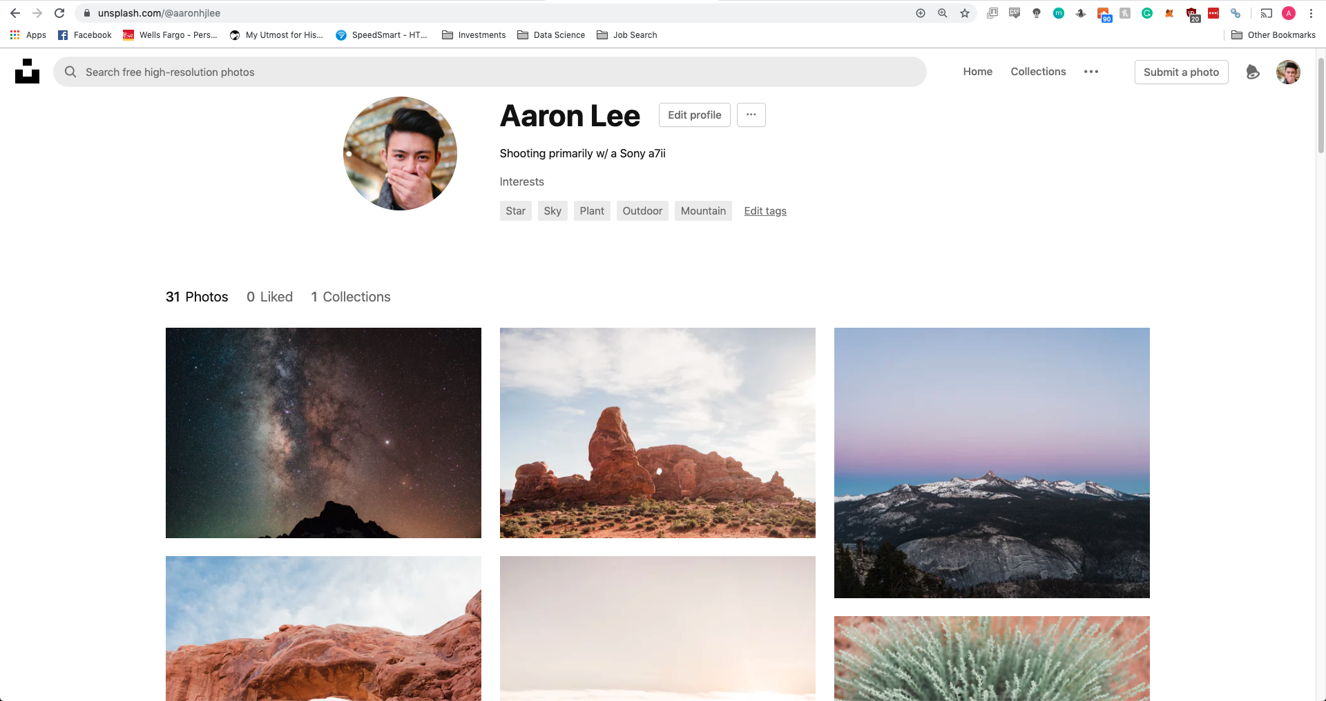
Unsplash.com/users/aaronhjlee
Notes:
Main reason I chose was Unsplash because they give a weighted average of color in hex code.
Other sites did not provide color through API requests photo metadata
A little more about that later…
Also I post my photos on there, here’s my link and my profile page

Slide 5


How do you measure use engagement?
Notes:
Like I said, pictures can be

Slide 6
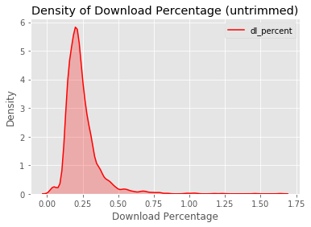
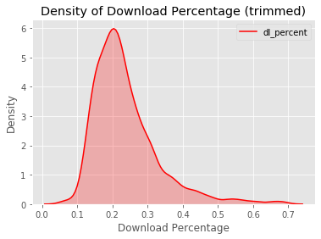
P-Value: 0.3301 ~
Not a normal distribution
Alpha = 0.05
Notes:
We know we have to back any findings with data so we know we want to do a test, but which test?
Shows long tail test, we cut out bottom 1% and top 1% BECAUSE: (0.057% - 0.68%)
A photo could be skewing our graph if it has an abnormally low VIEW count, inflating the dl percentage
First thing we needed to figure out was if this thing was NORMAL
Quick glance, it doesn’t look like it, but we’ll check with: stats.normaltest(‘dl_percent’)
P-value: 0.3301

Slide 7

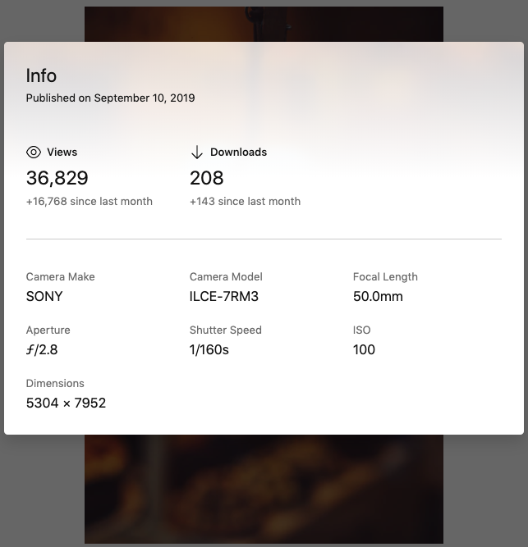
High Percentage
208
36,829
100
0.564%
Notes:
Why is this considered an outlier? (0.983%)
Unproportionally high percentage due to when it was uploaded
Not representative most pictures

Slide 8
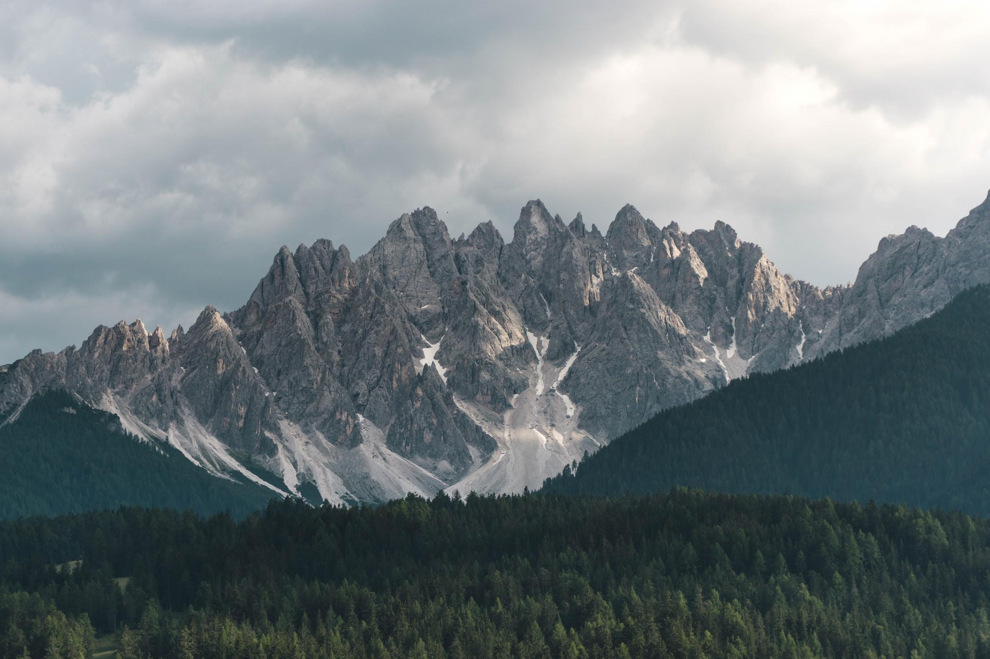
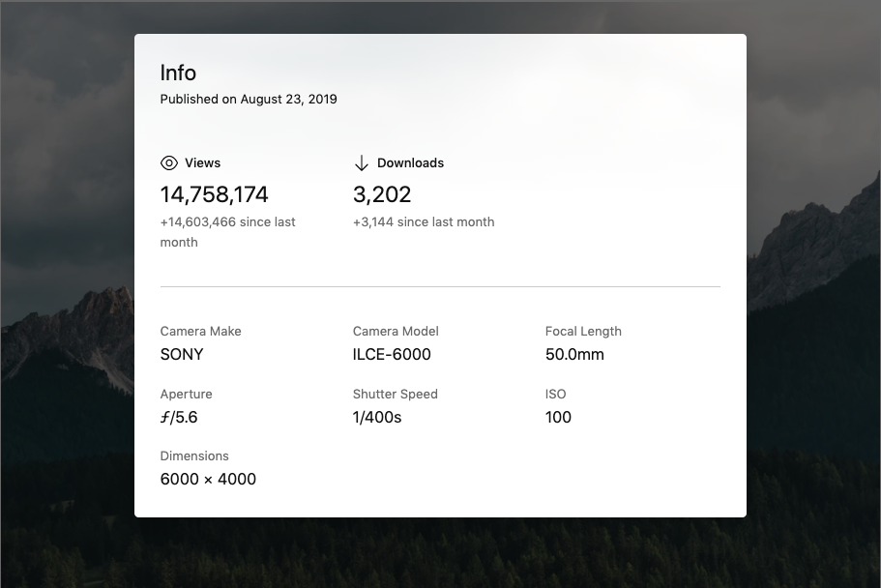
Low Percentage
3,202
14,758,174
100
0.0217%
Notes:
Why is this considered an outlier? (0.017%)
Unproportionally low percentage due to when it was uploaded
Not representative most pictures

Slide 9
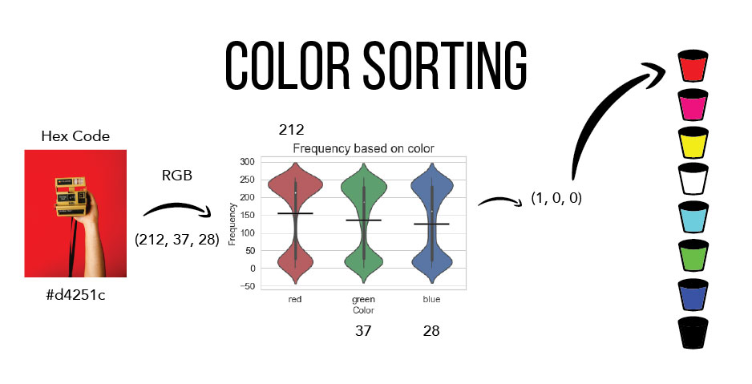

Slide 10
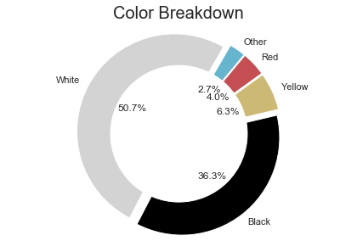
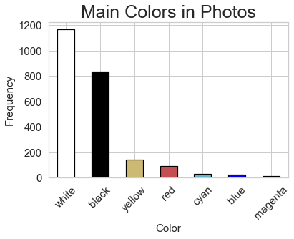

Slide 11
Hypothesis Test
Question: Does the color in an image affect whether a person engages with that picture or not?
Mann-Whitney U Test
Does the color in an image affect whether a person engages with that picture or not?
Notes:
U Test used to compare differences between 2 independent groups and is not normally distributed.

Slide 12

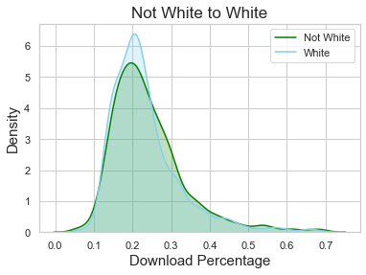
Non-White against White Pictures
Null Hypothesis: Engagement for not-white picture > engagement of white pictures
Alpha = 0.05 / 5 = 0.01
P-value: 0.990
Conclusion: Fail to reject the null
Notes:
We divided the alpha by 5 because according to the multiple comparison problem, if we are performing simultaneous tests, the likelihood of a ‘significant finding’ is increased, so to compensate, we lower alpha by dividing it by the number of tests we are conducting.

Slide 13
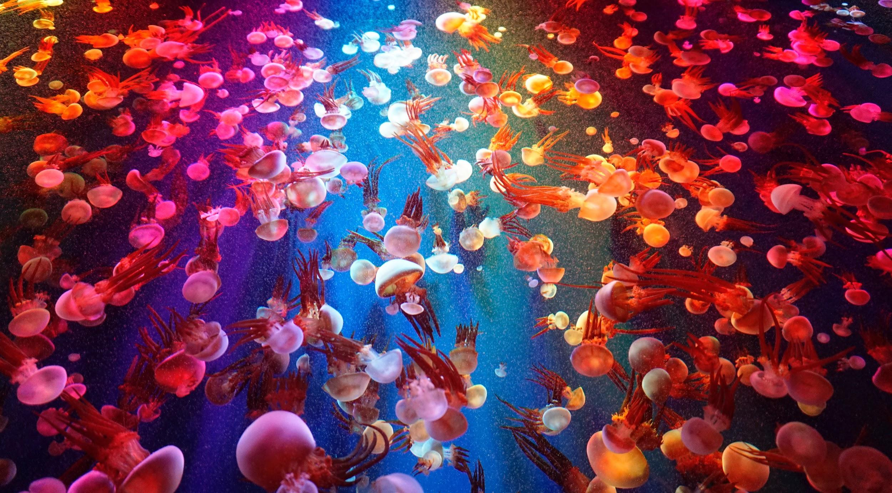
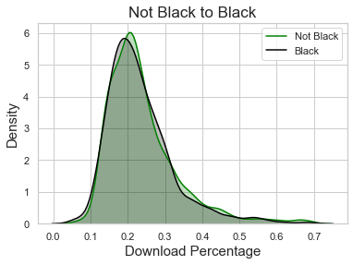
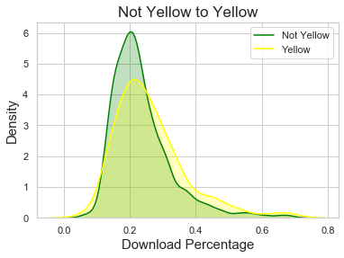
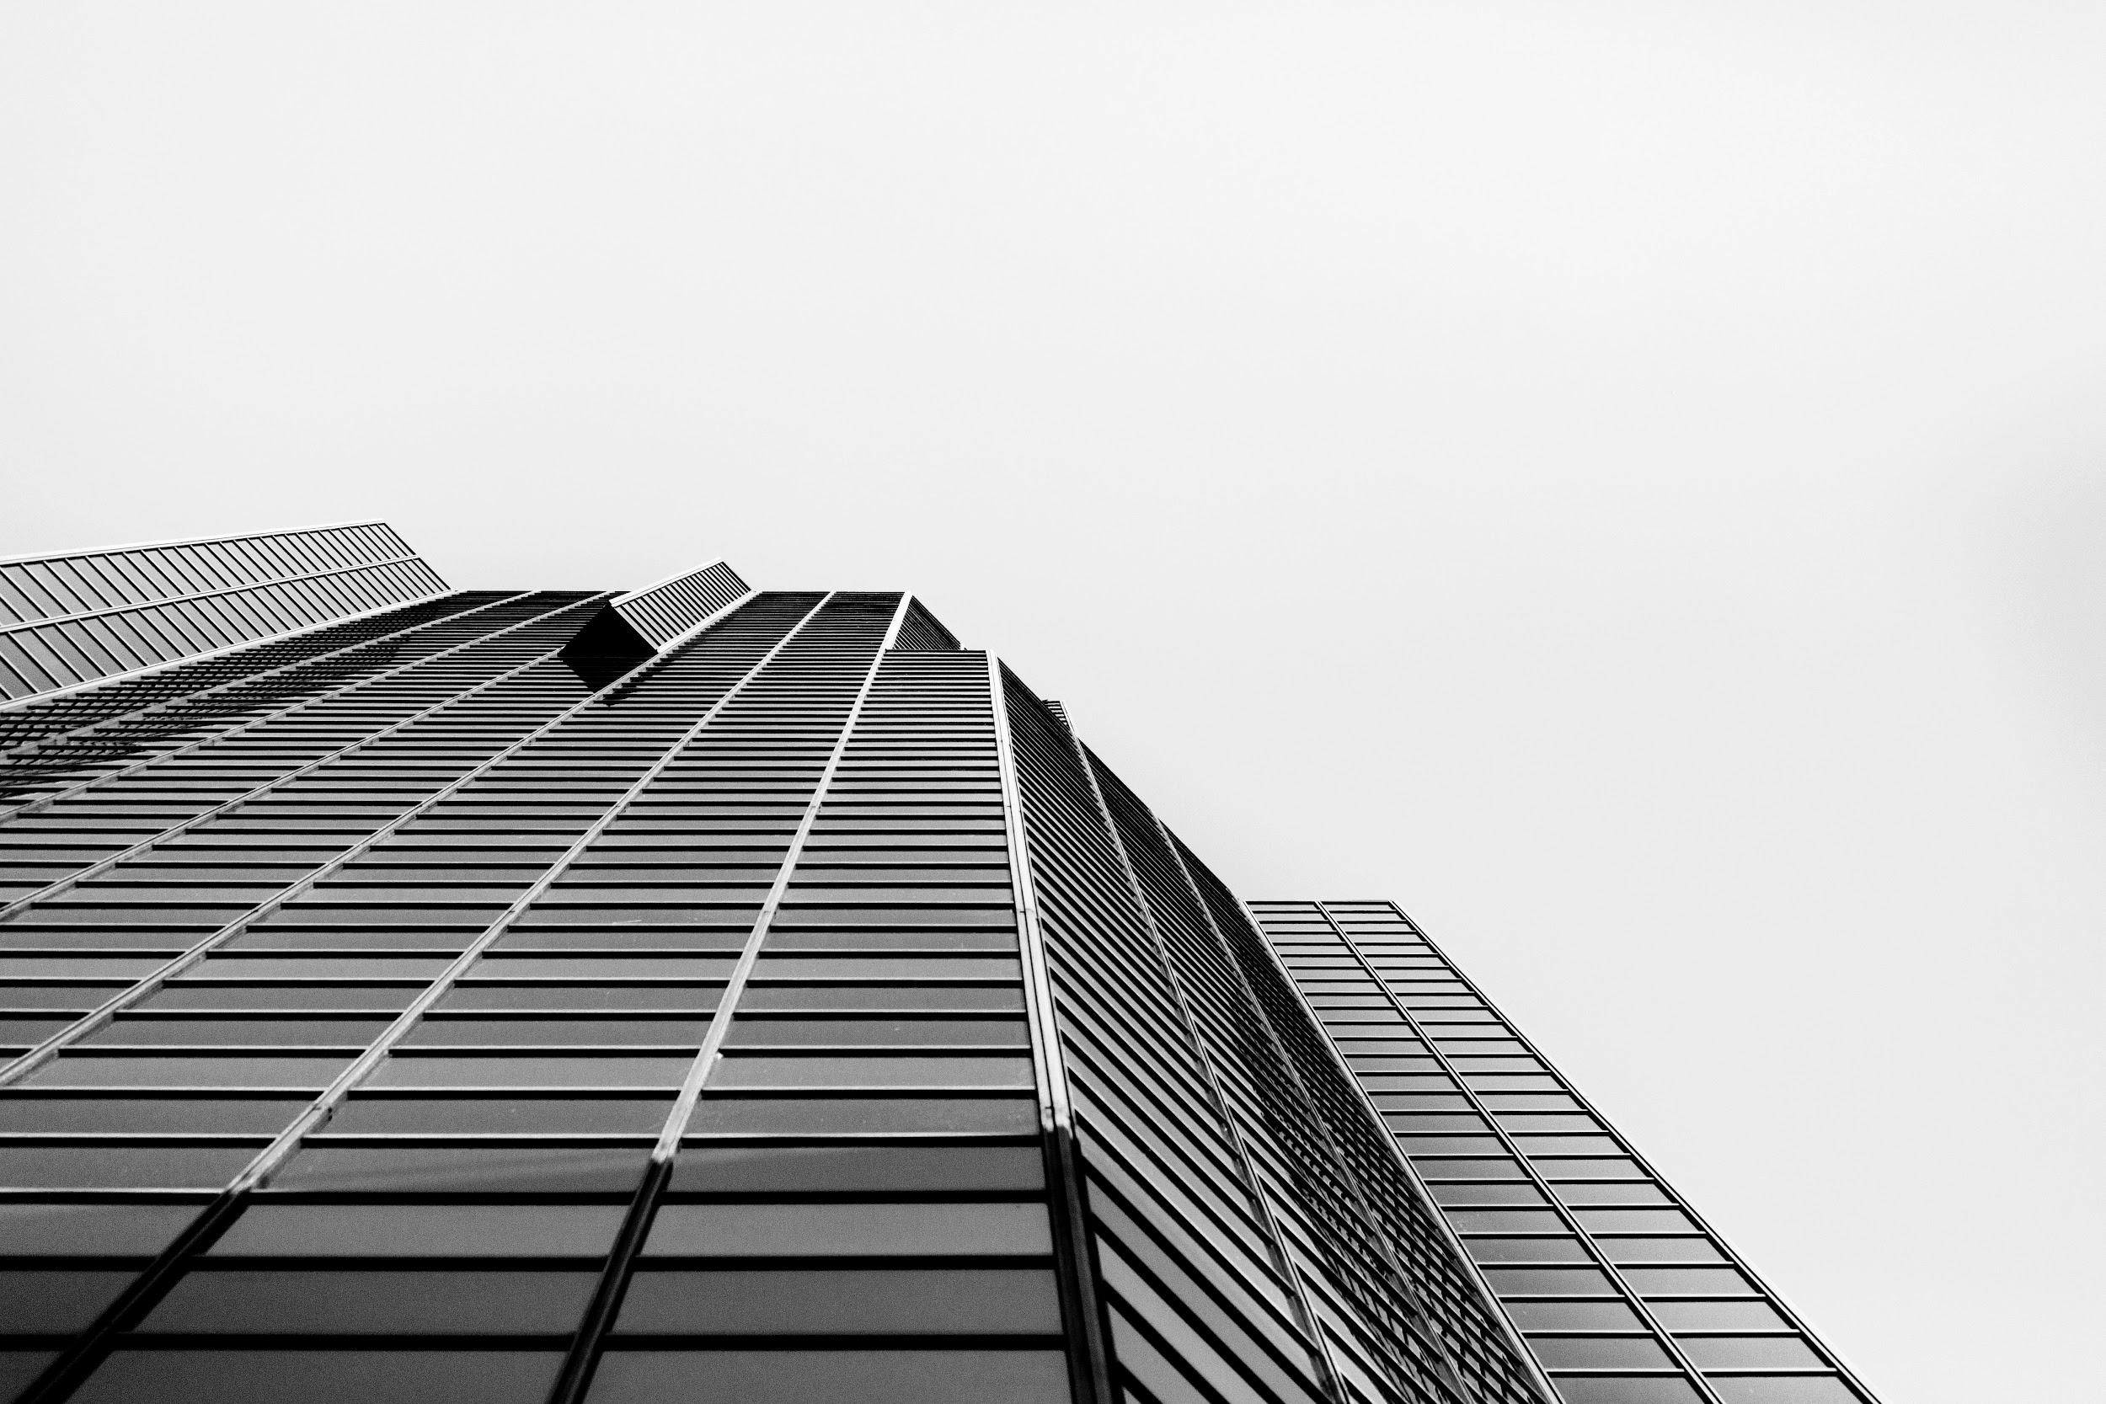
Multiple U-Tests
P-Value: 0.894
Conclusion: Fail to reject the null
P-Value: 0.001
Conclusion: Reject the Null

Slide 14
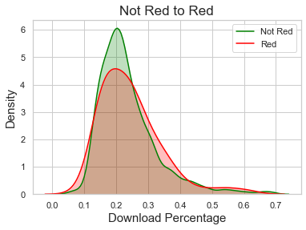
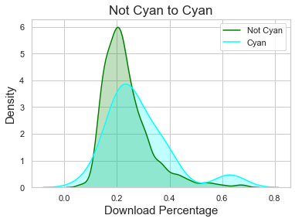
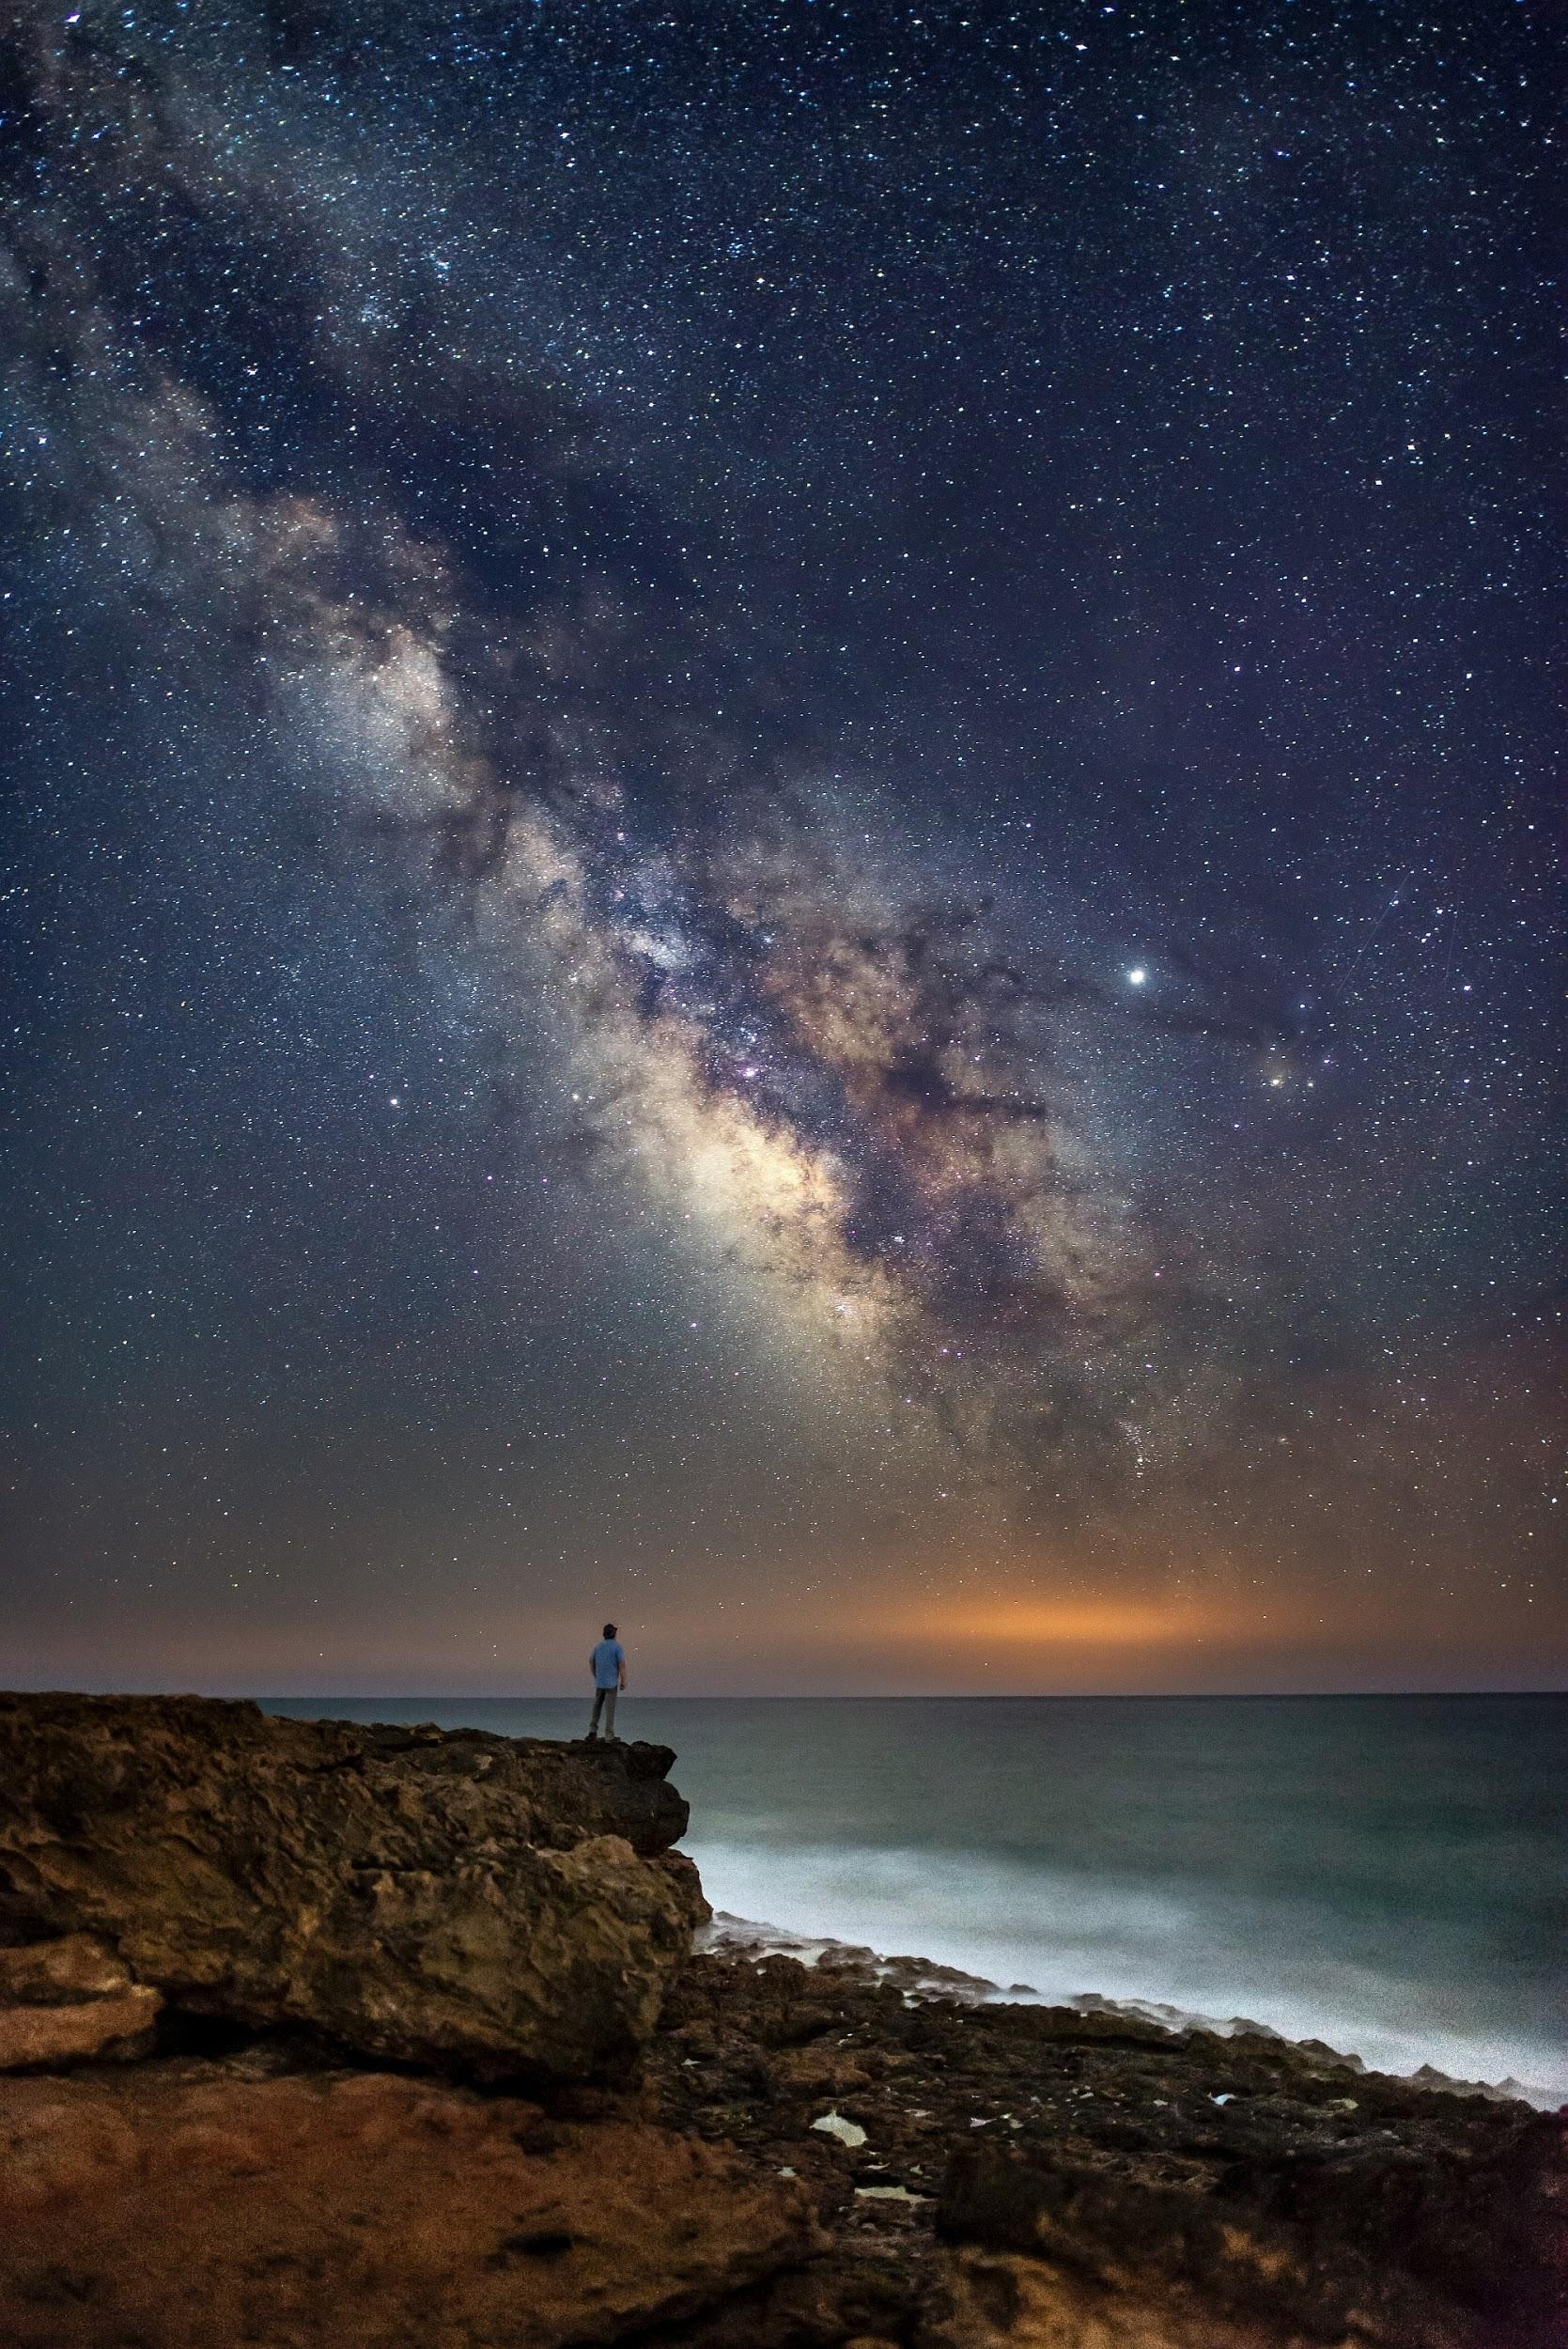
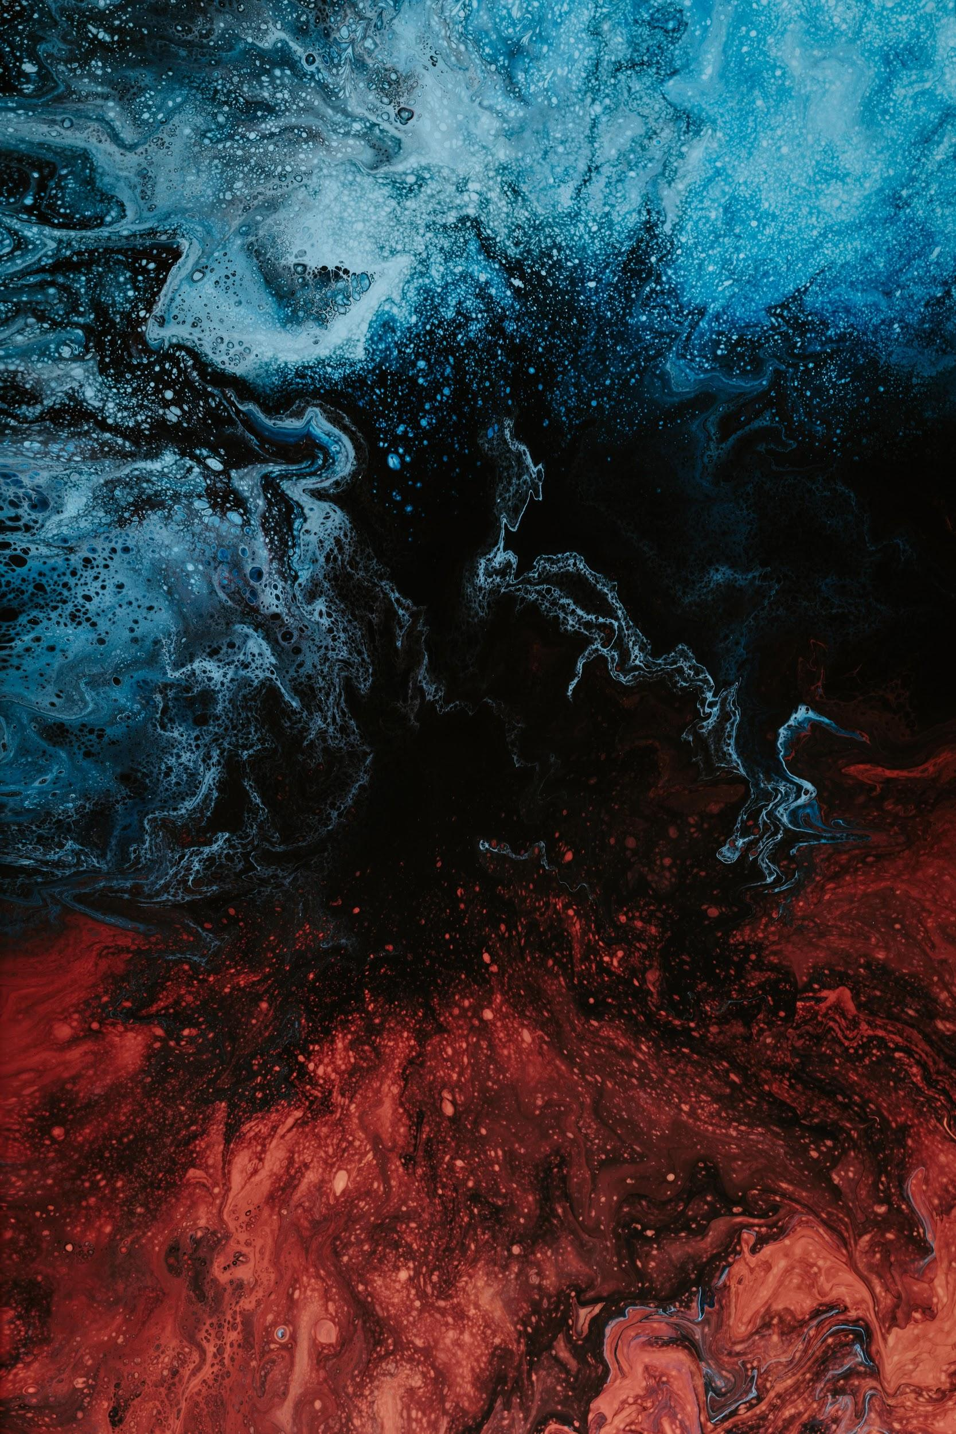
Multiple U-Tests (cont.)
P-Value: 0.198
Conclusion: Fail to reject the null
P-Value: 0.006
Conclusion: Reject the null

Slide 15
Review
Question: Does the color in an image affect whether a person engages with that picture or not?
It might! Only colors labeled yellow and cyan showed significance.
Photos labeled by their weighted average may not be accurate.

Slide 16
Thank You!
GitHub: /aaronhjlee
Linkedin: /aaronhjlee
Unsplash: @aaronhjlee

Slide 17
